Slide 1


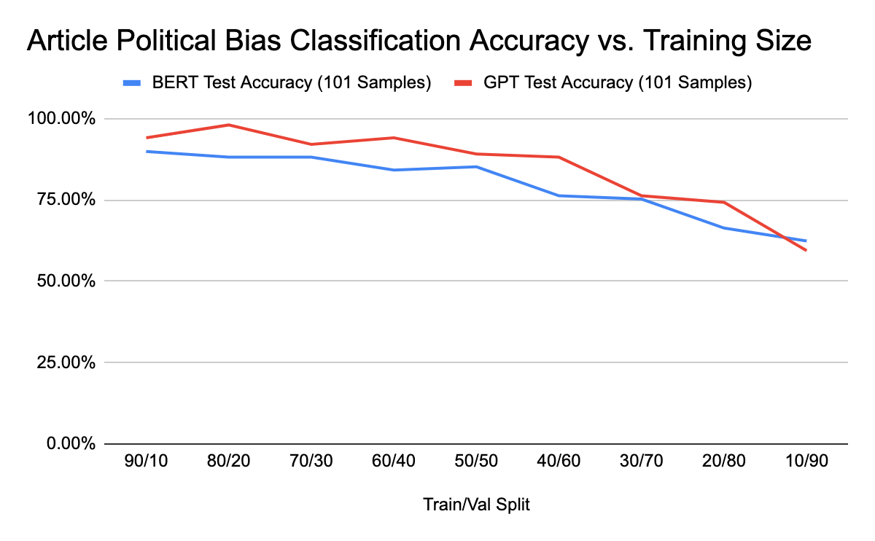
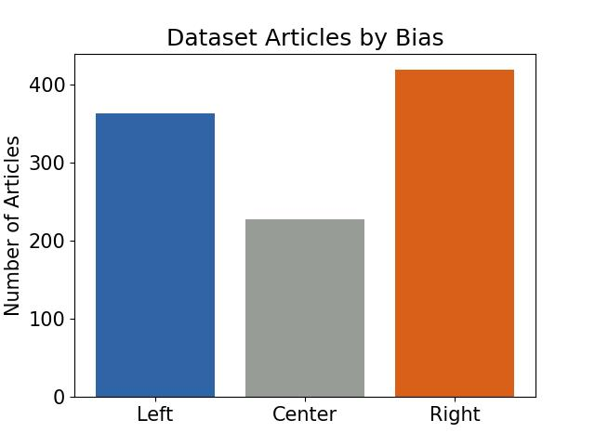
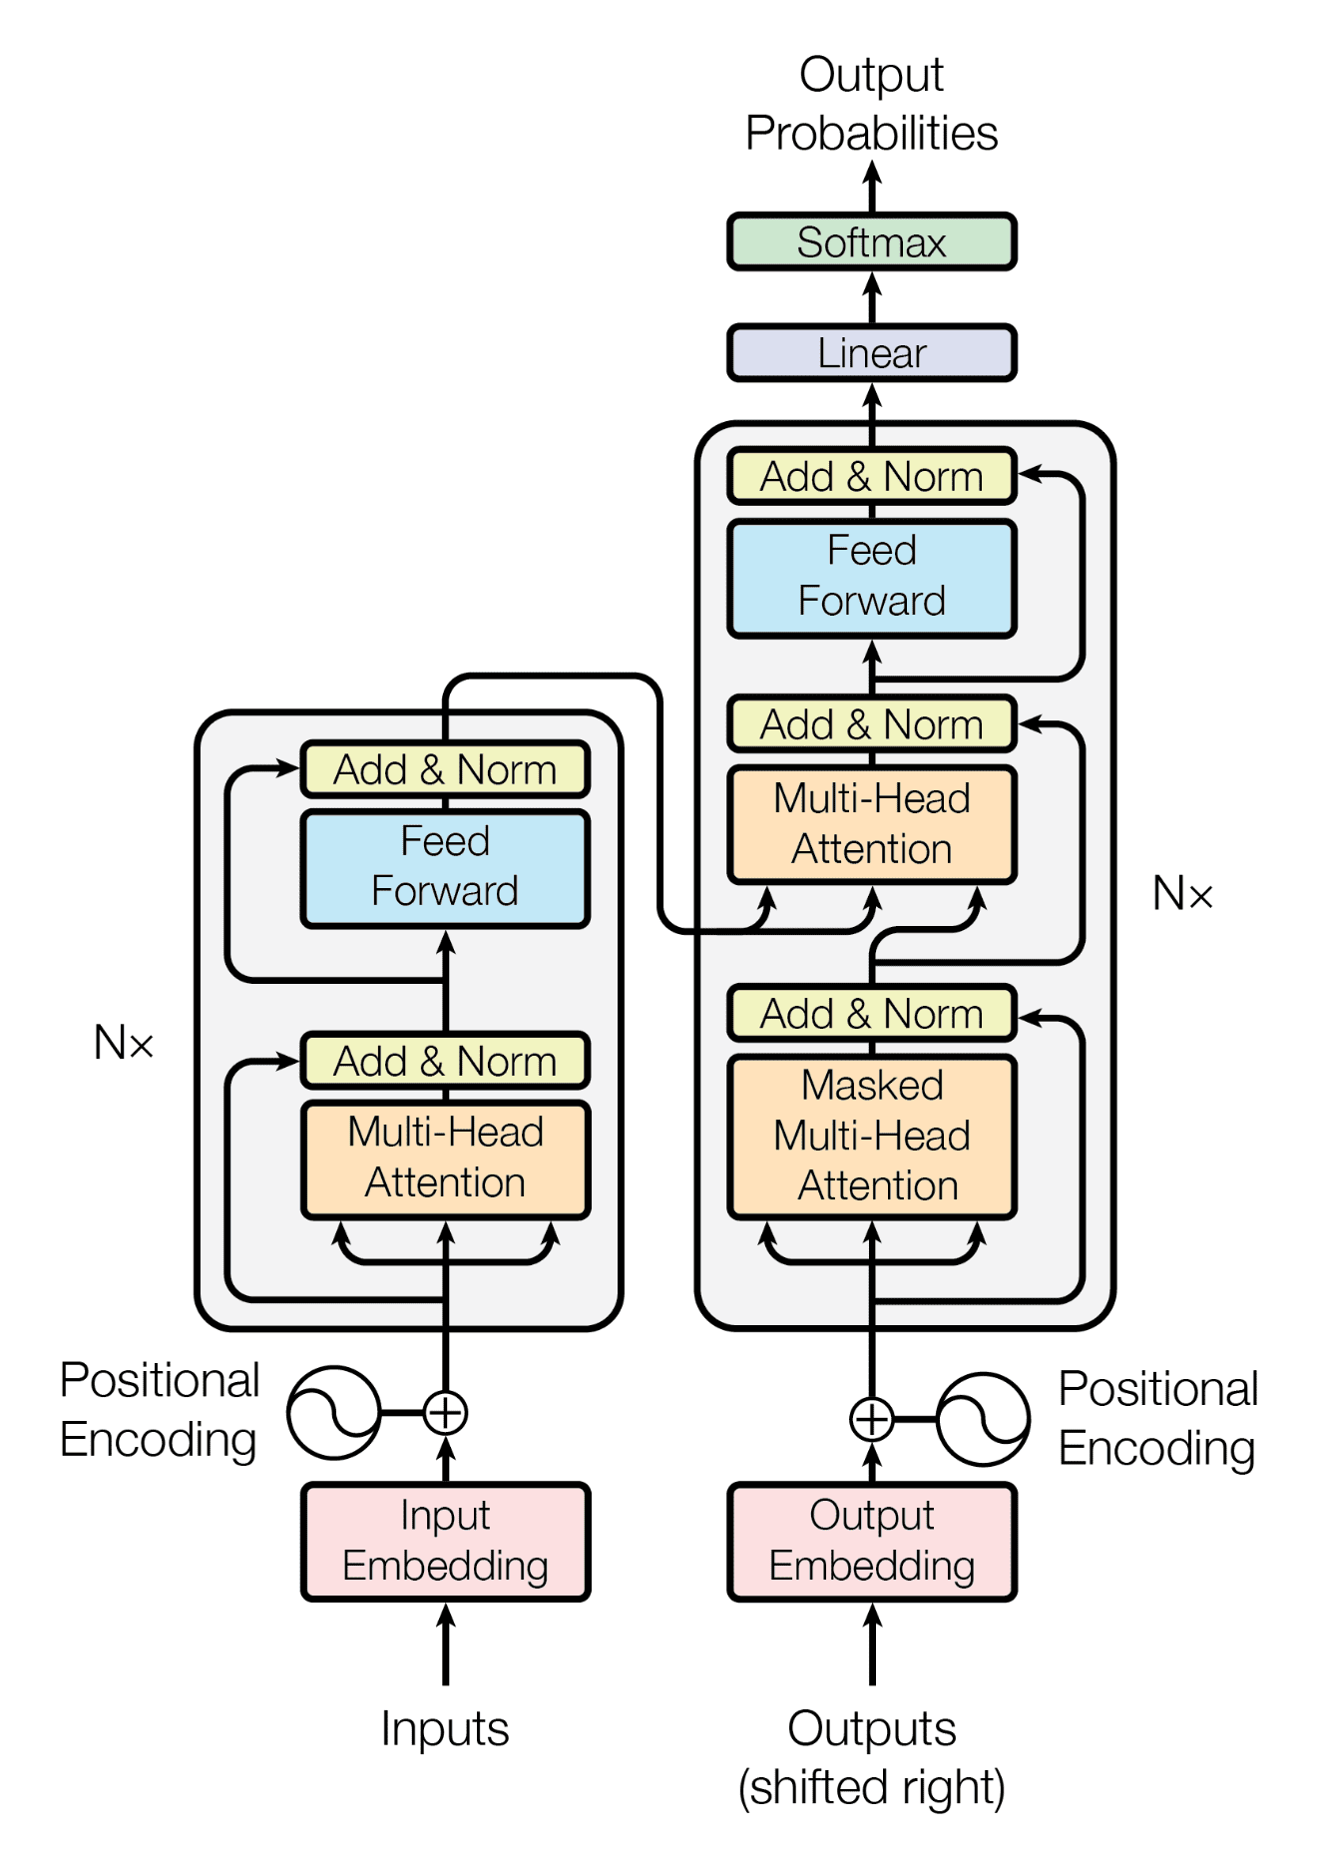
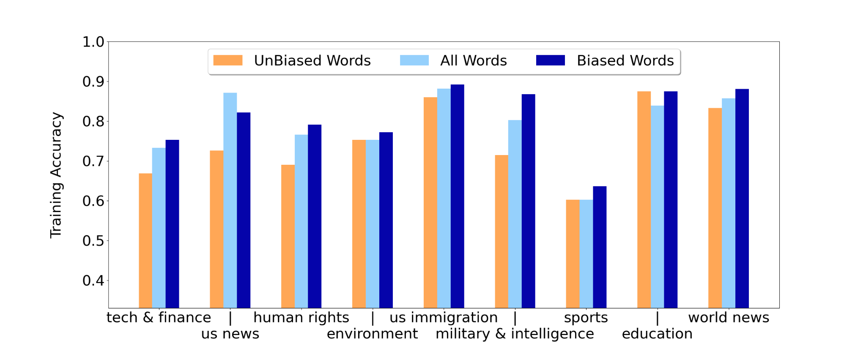
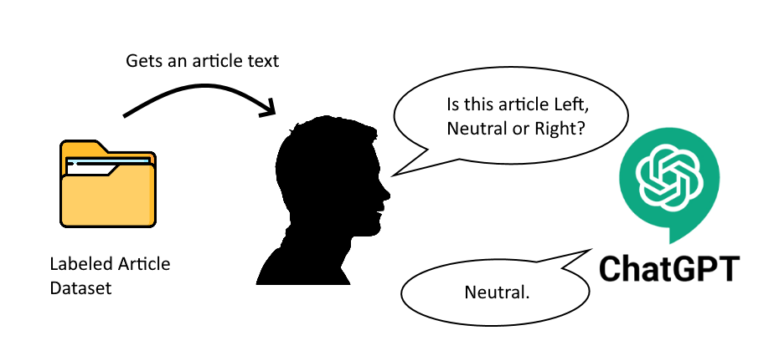
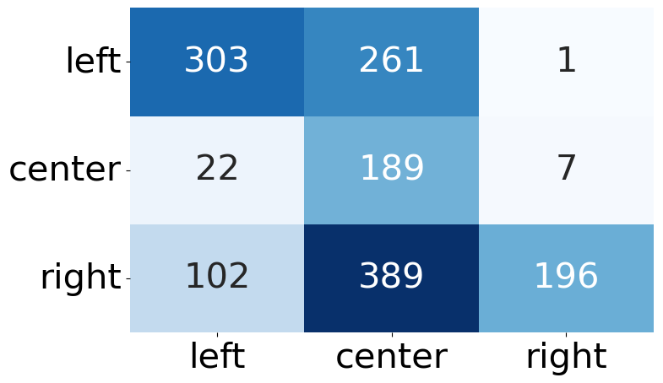
Left, Right, or Neutral? Run it Bias First!
Political Bias Article Classification using Supervised and Unsupervised Learning
Gabrielle Jones, Jessica Ma, Shivam Patel, Wesley Tsai, Tao Zhou
gabs@umich.edu, jqma@umich.edu, shivamgp@umich.edu, wesleyjt@umich.edu, taozhou@umich.edu
EECS 545: Machine Learning – Winter 2023
Introduction
Supervised Methods
BERT and GPT-2
Supervised Results
BERT and GPT-2
In today’s increasingly polarized political environment, media contains subliminal messaging through word choice and phrasing that is inherently biased towards a specific narrative.
Preprocessing Text: Removal of punctuation and non utf-8 characters. Stop words maintained for context around keywords.
Transformer Models for Natural Language Processing
(NLP)
BERT
Bidirectional Encoder Representations from Transformers
Developed by Google
One of the most powerful NLP models for text classification
Bidirectional Encoder - captures context on both sides of a token
GPT-2
Generative Pre-trained Transformer 2
Developed by OpenAI
Traditionally used for text generation
Can handle longer text sequences than BERT
Unidirectional model
Goal: Political bias detection with minimal injection of human bias into training data.
Dataset
MBIC (Media Bias Including Characteristics) dataset from Kaggle was used.
Articles were parsed for text using Newspaper3k Python Package.
Test accuracy of up to
89.87% (BERT model)
98.02% (GPT-2 model)
The GPT-2 model performed better than BERT for most train/val splits
This very high accuracy likely was reached due to the very polarized MBIC dataset
Unsupervised Methods
Naive Bayes Results
Ask ChatGPT: We explored ChatGPT’s capabilities for classifying articles as politically left, neutral or right on a sentence level
and an article level (first 4096 tokens)
Fine-tuning and Hyperparameter Search
BERT and GPT-2 pre-trained models fine-tuned for article political bias classification with appended fully connected layers
Used a variety of train/test splits to evaluate accuracy vs. training data size
Sigopt used for hyperparameter tuning to optimize performance
Weight decay and dropout on the final classification layer were used to prevent overfitting
Highly context dependent
Biased words dominate
Unsupervised Results
Lowest accuracy: Sports are generally not highly biased
Most stable: Education
Most volatile: U.S. News and Military & Intelligence
Chat GPT Prediction
Naive Bayes Methods
Preprocessed
Text by Category
Add or subtract biased phrases
Future Work
Further evaluate supervised results for method inconsistencies and BERT/GPT-2 model feature selection
Re-training and evaluating supervised classification when training data is injected with further human bias
Further Naive Bayes Optimization with hyperparameter tuning
Fine-tune ChatGPT (GPT-3.5 or GPT-4) model for improved classification accuracy
MBIC
Label
Biased words/phrases by category
No biased phrases
Only biased phrases
Vectorized Text
Vectorized Text
Vectorized Text
ChatGPT achieved 46.8% accuracy on political alignment
Majority of articles were classified as Neutral by ChatGPT
83.1% of misclassified articles were predicted as Neutral.
ChatGPT performs worst in classifying Politically Right articles
Naive Bayes
Naive Bayes
Naive Bayes
Acknowledgements
Biased words were parsed by eliminating stopwords
Categories were generalized to nine overarching news segments
We would like to thank Prof. Honglak Lee, GSI Jongwook Choi, GSI Yunseok Jang, and GSI Anthony Liu for a great learning experience in this course and all the assistance we received on this project.

